Slide 1
Acoustic Emissions Based Hearing Loss Detection for New Born Babies Using Embedded System
Team Members
Guided By
M. Balaji (920819106008)
V. Divesh (920819106016)
S. Harishwar (920819106019)
J. Kishorekrishnaa (920819106026)
Mr. P. Abdul Samad, M.E.,
Assistant Professor-ECE
NPRCET

Slide 2

Objective
New born hearing diagnosis are very important for the early discover of problem.
That might affect their hearing and consequently their communication.
Babies may hear or respond to some sounds, but this is not enough indication that they can hear all the sounds properly.
The early diagnosis of hearing by the functionality of the internal cochlea using Otoacoustic Emission is necessary.

Slide 3
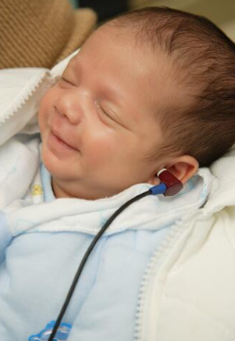
Abstract
The low-cost microcontroller developed device is efficient and sensitive as it is capable of generating and capturing signals.
The external ear canal, as well as analyzing signals and determining the efficiency of the inner ear.
The microcontroller based on generating two sinusoidal waves with different frequencies that transferred.
Analog to Digital Convertor (ADC) will be responsible of the control operation for all the system parts.
The input signals are generated by Pulse Width Modulation technology (PWM).
Frequencies range value (0.5-8) kHz which is the human auditory range that a person can hear.

Slide 4
Literature Survey
S.I | TITLE | AUTHOR | ABSTRACT
1 | DESIGN AND IMPLEMENTATION OF LOW-COST MEDICAL AUDITORY SYSTEM OF DISTORTION OTOACOUSTIC USING MICROCONTROLLER | ABDULRAFA H. MARAY, OMAR IBRAHIM ALSAIF*, KIFAA H.TANOON(2022) | The device is designed to be low-cost, efficient, and sensitive, capable of generating and capturing signals from the external ear canal. The proposed algorithm for the microcontroller is based on generating two sinusoidal waves with different frequencies.
2 | Detection of hidden hearing loss using distortion product otoacoustic emissions in adults with normal audiograms | Seyed Amir Hossein Hosseini et al. (2019) | This study investigates the use of DPOAEs for detecting hidden hearing loss in adults with normal audiograms. The results show that DPOAEs can be a useful tool for identifying hidden hearing loss in individuals with normal audiograms.
3 | Evaluation of DPOAE screening in neonatal hearing loss in a tertiary care hospital of Nepal | Rajendra Kc et al. (2021) | This study evaluates the effectiveness of DPOAE screening for neonatal hearing loss in a tertiary care hospital in Nepal. The results show that DPOAE screening is an effective tool for early detection of hearing loss in newborns in a resource-limited setting.
4 | Distortion product otoacoustic emission changes after contralateral noise exposure in human subjects | Kaibo Nie et al. (2021) | This study investigates the effects of contralateral noise exposure on DPOAEs in human subjects. The results suggest that DPOAEs are sensitive to the effects of noise exposure and can provide a useful tool for assessing the risk of noise-induced hearing loss.

Slide 5
Medical Examination of the Cochlea
There are two methods for examining the human ear using acoustic devices; Transient Evoked Otoacoustic Emissions (TEOAE) and Distortion Product Otoacoustic Emissions (DPOAE) method, which are explained as following:
TEOAE: Sound signals are generated at different frequencies, and pulses according to international standards, to stimulate the cochlea which will generate a sound signal which can be received by sound waves sensor.
DPOAE: is a more common method. DPOAE is a medical amplifier device that works to enlarge, filter and convert the input signals into audio signals that the human ear can hear. It contains a button to enlarge from 20 dB to 40 dB as needed.
This method was applied in this study by generating two audio signals (sine wave) at different changeable frequencies ranging between 0.5-8 kHz. These two signals go to the amplifier to be converted into sound waves and then go to the ear to stimulate the cochlea.
The difference between these two signals is ,
F1 = 1.2 × F2.

Slide 6
Existing System
Currently, the detection are hearing loss in newborn babies often relies on traditional methods such as the Auditory Brainstem Response (ABR) and Otoacoustic Emissions (OAE) tests.
(ABR) and Otoacoustic Emissions (OAE) tests, which are not primarily based on embedded systems.
The ABR test measures the electrical activity are the auditory pathway in response to sound stimuli, while the OAE test measures the sounds produced by the inner ear in response to external stimuli.
Disadvantage
Cost
Equipment Complexity
Time-Consuming
Subject Cooperation
Limited Screening Coverage

Slide 7
Proposed System
The “Arduino uno” is designed to be low-cost, efficient, and sensitive, capable of generating and capturing signals from the external ear canal and analyzing signals to determine the efficiency of the inner ear.
Using PWM technology with a range of frequencies between 0.5-8 kHz.
The proposed algorithm for the microcontroller is based on generating two sinusoidal waves with different frequencies.
It calculate (FFT) the frequency to decibel and we have create a “file” to compare the previously stored data and output data.
Then the result will be displayed in the LCD Display.

Slide 8
Block Diagram
12c cart
Pre
Amplifier
DOPE
12c cart
Pre
Amplifier
DOPE
Ear of Human
Ear of Human
Microcontroller Unit (MUC)
(“Arduino uno” )
Microcontroller Unit (MUC)
(“Arduino uno” )
16*2 LCD Display
16*2 LCD Display
PC-GUI
Analyses
PC-GUI
Analyses
MSD card
MSD card

Slide 9
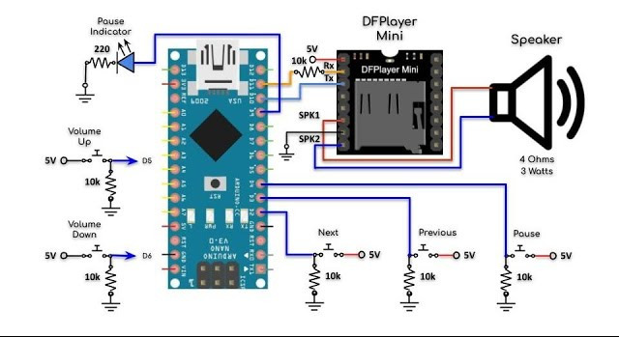
Circuit Diagram
Microphone 1
Microphone 2
Arduino Uno
Arduino Uno

Slide 10
Hardware Used
Microcontroller: An embedded system based on a microcontroller such as “Arduino uno” is used to process the signals from the acoustic sensors.
DPOAE probe: This is a specialized earpiece that contains a speaker and microphone. The probe is inserted into the ear canal to deliver the test stimulus and measure the resulting sound emissions.
Display: The results of the hearing test can be displayed on an LCD screen or LED indicators.
Analog-to-digital converter (ADC): The amplified signals are converted into digital signals using an ADC.
Power supply: The system requires a stable power supply to function properly.
Memory Module: This module is used to store (file) data and compare to our previous data.

Slide 11
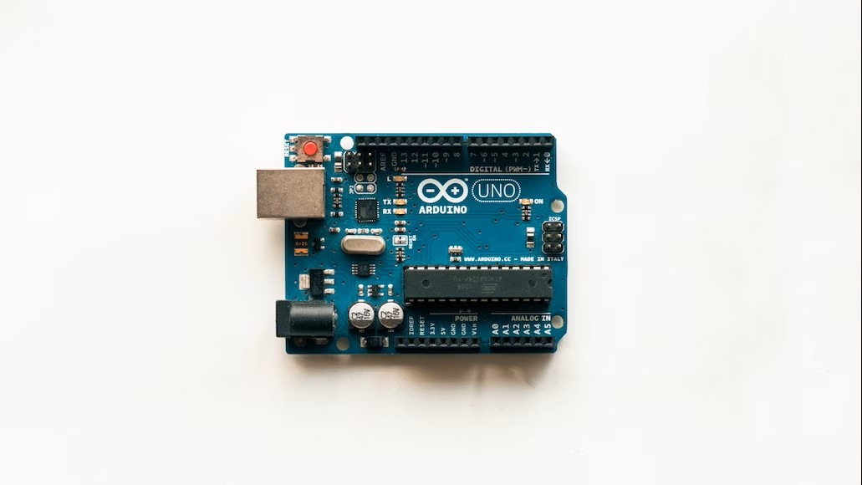
Arduino uno Microcontroller
Core: ATmega328P
Clock speed: Up to 16 MHz
Flash Memory: 32 KB
SRAM: 2 KB
EEPROM: 1 KB
Digital I/O pins: Up to 14 (depending on the board)
Analog input pins: Up to 6 (depending on the board)
Input voltage (recommended): 5-12v
Input voltage (limits): 6-20v
DC current per I/O pin: 20 mA
Operating voltage: 5V
Operating temperature range: -40°C to 85°C

Slide 12
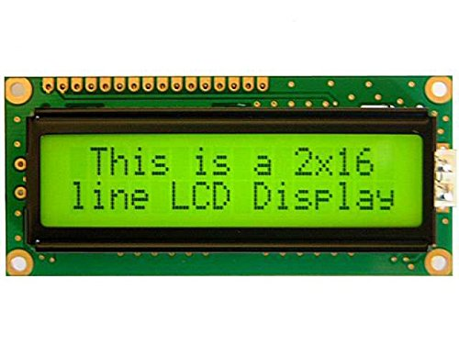
16*2 LCD Display
A 16x2 LCD display is a type of alphanumeric display that consists of 16 columns and 2 rows of LCD (Liquid- Crystal Display) dots or segments arranged in a rectangular shape.
The display can be used to display text, numbers, and symbols, and is commonly found in electronic devices such as calculators, digital clocks, and digital thermometers.
Each dot or segment on the display represents a single character, such as a letter, digit, or symbol.
The 16x2 LCD display can be used in a wide range of applications, including digital clocks, thermometers, electronic notice boards, and measurement instruments.
They are commonly used in DIY projects and prototyping, and can be interfaced with popular development boards such as the Arduino and Raspberry Pi.

Slide 13
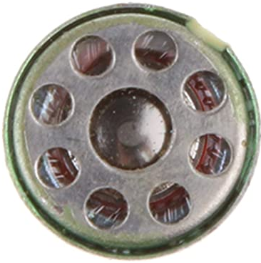
Speaker
It can be used to control a speaker to generate audible sounds.
To use a speaker with Arduino uno, you will need to connect it to one of the microcontroller's output pins.
Once the speaker is connected, you can use Arduino uno code to control the sound that is produced.
You can generate different frequencies and durations of sound by toggling the output pin of the microcontroller.
Arduino uno provides a built-in library called "TIM" that allows you to generate PWM signals on specific output pins.
The TIM library provides various functions that can be used to configure the timer peripheral and generate PWM signals with different frequencies and duty cycles.

Slide 14
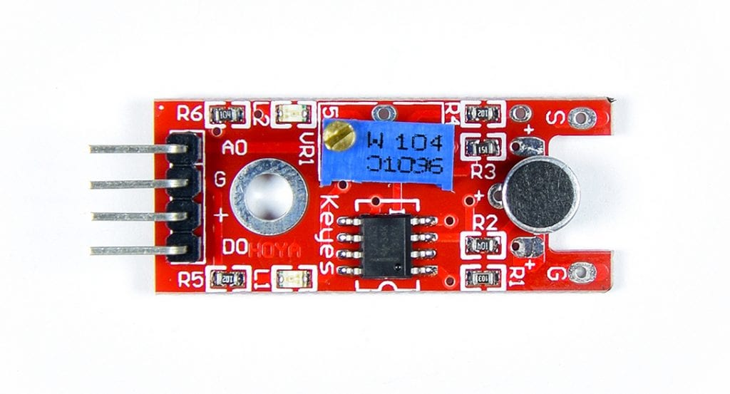
Microphone
A microphone is a device that converts sound waves into an electrical signal.
This signal can then be amplified, recorded, or transmitted to other devices for further processing.
This creates an electrical signal that is proportional to the sound waves and can be amplified and processed as needed.
When the sound waves hit the diaphragm, it moves closer to or farther away from the charged plate, creating a variation in voltage
This voltage can be amplified and processed to produce a clear, high-quality audio signal.

Slide 15
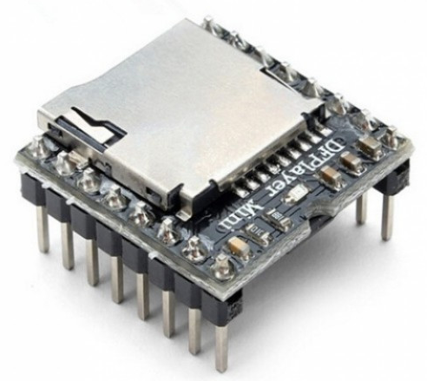
Memory Module
EEPROM: EEPROM (Electrically Erasable Programmable Read-Only Memory) is a type of non-volatile memory that can be read and written to. EEPROMs can be interfaced with the Arduino using the Wire library, which allows for reading and writing data to the memory.
SD Card: SD (Secure Digital) cards are commonly used for storing large amounts of data on the Arduino. An SD card module can be connected to the Arduino using the SPI (Serial Peripheral Interface) bus and the SD library, which provides functions for reading and writing data to the card.
Flash Memory: Flash memory is a type of non-volatile memory that is commonly used for storing program code on the Arduino. The ATmega microcontrollers used in most Arduino boards have built-in flash memory, which can be programmed using the Arduino IDE.
SRAM: SRAM (Static Random Access Memory) is a type of volatile memory that is commonly used for storing temporary data on the Arduino. The ATmega microcontrollers used in most Arduino boards have built-in SRAM, which can be accessed using the AVR Libc library.

Slide 16
Software Algorithm
The microcontroller analyses the signals by (FFT) using C++ programming language.
To remove unwanted noise, this chart gives the percentage of diagnosis and review of results directly on the LCD screen.
start
Initialization data transform, 12c and LCD
Read and Store Data in the Buffer
FFT analyses of buffer data by using python tool
Next new
address
YES
Noise
If out data
NO
Compare Result with previously store data
Out put the result on lcd
end

Slide 17
Description
The system generates different sound wave frequencies (sine waves) that can be tuned based on international standards by the Microcontroller.
The signals generated inside the ear will be captured by the sound sensor and transferred to the (MCU) to be analyzed, filtered and processed.
The difference between these two signals is [ F1 = 1.2 × F2].
The received signals are combination of many signals, including the original signals transmitted F1, F2 and the signal to be captured Fd that generated by cochlear stimulation.
The rest of the signals are considered as noise.(Using Band Pass Filter- It consider the range of signal (0.5-8 khz))
F2 | 0.5 | 1.0 | 1.5 | 2.0 | 2.5 | 3.0 | 3.5 | 4 | 4.5
F1 | 0.6 | 1.2 | 1.8 | 2.4 | 3 | 3.6 | 4.2 | 4.8 | 5.5

Slide 18
FFT Algorithm Calculation
The frequency of 1000 Hz and an intensity equal to the threshold of human hearing would have a sound pressure level of 0 dB SPL.
At approximately 1 month of age, DPOAEs (1-8 kHz),
For Example;
if you want to calculate the sound pressure level resulting from two frequencies of 1000 Hz and 2000 Hz, and the reference sound pressure level is 20
Reference level = 20
Ratio = (1000 Hz * 2000 Hz) / 20 = 100000
dB SPL = 20 * log10(Ratio) = 20 * log10(100000)
= 120 dB SPL

Slide 19
Python Tool to Calculate FFT
The difference between these two signals is [ F1 = 1.2 × F2].
F2 | 0.5 | 1.0 | 1.5 | 2.0 | 2.5 | 3.0 | 3.5 | 4 | 4.5
F1 | 0.6 | 1.2 | 1.8 | 2.4 | 3 | 3.6 | 4.2 | 4.8 | 5.5
dB SPL | 0.7 | 1.4 | 2.1 | 2.8 | 3.5 | 4.2 | 4.9 | 5.6 | 6.5
+ .5 | 1.2 | 1.9 | 2.6 | 3.3 | 4 | 4.7 | 5.4 | 6.1 | 7
- .5 | 0.2 | 0.9 | 1.6 | 2.3 | 3.0 | 3.7 | 4.4 | 5.1 | 6

Slide 20
Result and Discussion
Begin by presenting the evaluation metrics used to assess the system's performance, such as accuracy, sensitivity, specificity, precision, and F1-score. These metrics provide quantitative measures of the system's ability to correctly identify newborn babies with hearing loss and those with normal hearing.
Performance Analysis: accuracy and other evaluation metrics, comparing them with existing methods or clinical standards. Highlight the system's strengths in correctly identifying hearing loss cases and its limitations, if any, in terms of false positives or false negatives.
Sensitivity and Specificity Analysis: Discuss the sensitivity and specificity of the system. Sensitivity represents the system's ability to correctly identify newborn babies with hearing loss, while specificity indicates its ability to correctly identify those with normal hearing. Analyze the system's performance in achieving a balance between sensitivity and specificity and discuss the implications for early detection and intervention, Comparison with Existing.
Methods: Compare the performance of the acoustic emission-based system with existing hearing loss detection methods, such as otoacoustic emission (OAE) or auditory brainstem response (ABR) tests. Highlight the advantages and limitations of the proposed system compared to traditional methods, including factors like cost, portability, ease of use, and suitability for newborns, Discussion of False Positives and False.

Slide 21
Future Scope:
Address the occurrence of false positives (indicating hearing loss when it is not present) and false negatives (failing to detect hearing loss).
Discuss potential causes for these errors, such as variations in the acoustic emissions, noise interference, or limitations of the classification algorithm.
Propose possible strategies for reducing false results and improving the system's accuracy, Clinical Relevance and Impact.
Discuss the clinical relevance and impact of the proposed system.
Emphasize the potential benefits of early detection of hearing loss in newborn babies, including timely intervention and improved long-term outcomes.
Consider the system's usability in clinical settings, its integration with existing healthcare workflows, and the potential for reducing the burden on healthcare professionals.

Slide 22
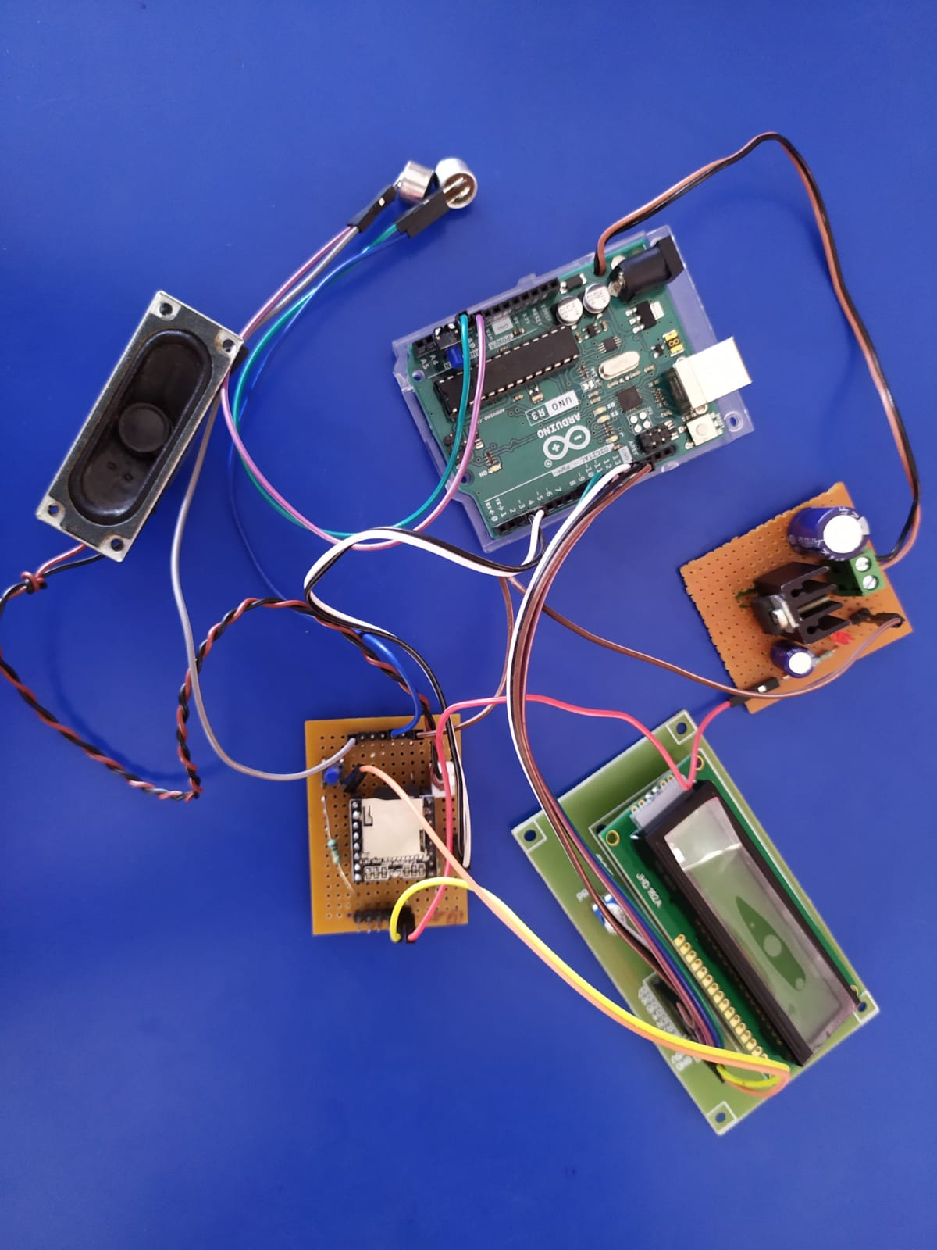

Slide 23
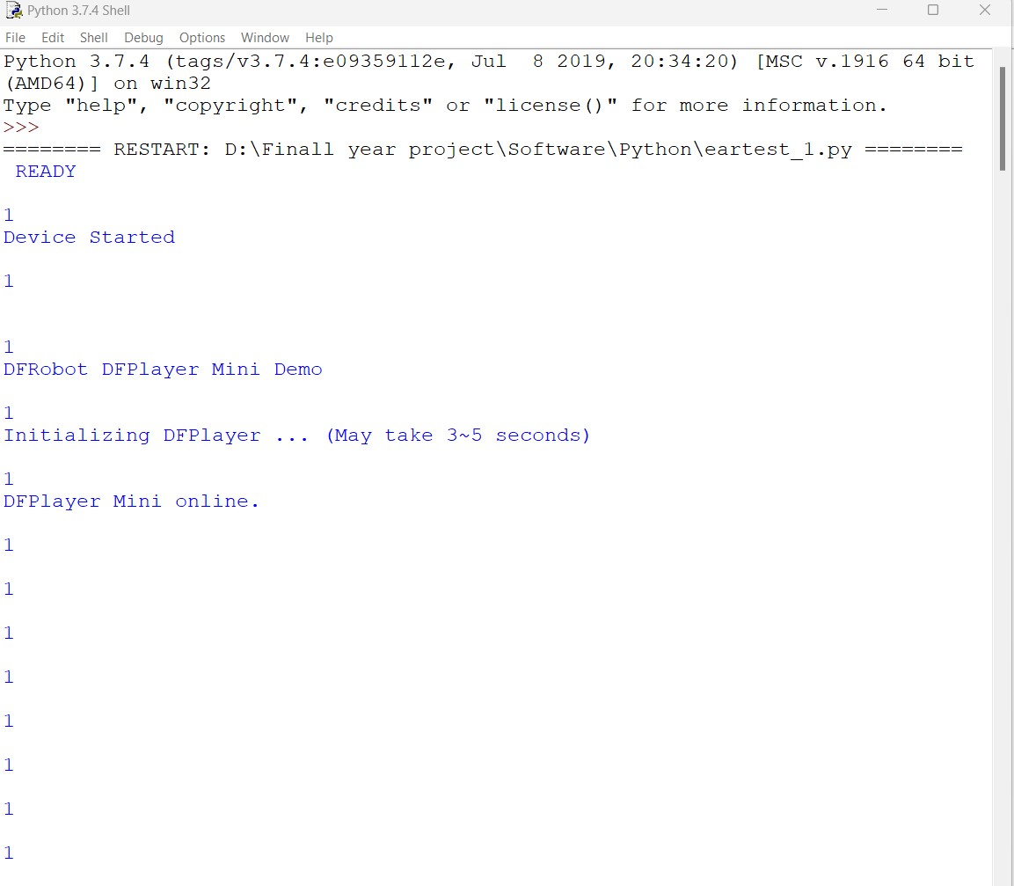
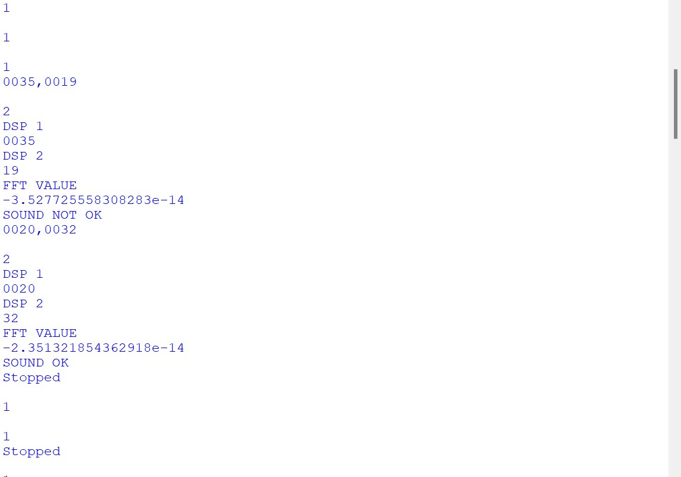
Microphone 1
Microphone 2

Slide 24
Conclusion
A new device of Distortion Otoacoustic system was designed, in order to meet the requirements of the medical device market in terms of providing an inexpensive device that works on a public microcontroller (Arduino uno).
The results shows a good capability of low-cost microcontroller to operate as a good device that used to diagnose ear problems for children.
Future Work
In future work, more sophisticated types of microcontrollers can be used, as well as the ability to program them by artificial intelligence algorithms in order to be more efficient and accurate.

Slide 25
Reference
Design and implementation of low-cost medical auditory system of distortion otoacoustic using microcontroller. No. 2 (2022) 1068 - 1077
American National Standards Institute (ANSI). (2017). Maximum Permissible Ambient Noise Levels for Audiometric Test Rooms. ANSI S3.1-1999 (R2017).
Sampaio, A. L. L., Diniz, M. M. L. P., Andrade, K. C., Queiroga, A. S., Menezes, P. L., & Nascimento, M. S. (2020). Association between distortion-product otoacoustic emissions and speech perception in adult cochlear implant users. Brazilian Journal of Otorhinolaryngology, 86(3), 287-294.
Khan, S., Sharma, M., & Balakrishnan, R. (2021). Determining the functional integrity of outer hair cells in noise-induced hearing loss using distortion product otoacoustic emissions. Noise & Health, 23(110), 143-151.
Li, J., Sun, Y., Li, Q., & Li, X. (2021). Effect of age on distortion product otoacoustic emissions in normal-hearing Chinese adults. Brazilian Journal of Otorhinolaryngology, 87(2), 179-184.
Nandalike, S., & Lau, C. (2021). Sensitivity and specificity of distortion product otoacoustic emissions for hearing screening in newborns. The Laryngoscope, 131(2), E440-E444.
Ruggles, T., Shinn-Cunningham, B., & Kidd, G. (2018). Stimulus factors influencing the measurement of distortion product otoacoustic emissions. The Journal of the Acoustical Society of America, 143(3), 1661-1677.

Slide 26
THANK YOU

